Slide 1

Applying Deep Learning to the classification of VPN and non-VPN encrypted network traffic
By Khalid Olowe-Makorie

Slide 2
The problem
This project aimed to solve the problem of classifying VPN and non-VPN encrypted traffic by using a machine learning based solution
More specifically it entails using a Convolutional Neural Network (CNN) to classify encrypted network flows

Slide 3
Why does network traffic classification matter?
There is a significant amount of internet traffic generated everyday
Traffic classification is needed to efficiently manage this traffic so that networks operate smoothly
Not all traffic is equally important
Classification can be used to distinguish between the different types of traffic and prioritise those that would provide the best Quality of Service (QoS)
Sources: (Malik, de Fréin et al. 2020), (Hurley, Sezer et al. 2011).

Slide 4
Why focus on encrypted and VPN encrypted traffic?
If a firewall is entirely oblivious to encrypted traffic it can be easily bypassed by malicious users
Similarly, the QoS of a network cannot be maintained if the encrypted traffic cannot be classified and treated with varying levels of priority
Sources: (Obasi and Shafiq 2020).

Slide 5
Why a machine learning based solution?
Deep Packet Inspection (DPI) and a port based approach are two common methods of traffic classification
However these methods are both flawed:
DPI is computationally expensive and is unsuited to encrypted traffic
Port based approaches have been rendered futile due to the use of dynamic ports instead of standardised ports
Sources: (Zander, Nguyen et al. 2005), (Mohammed, Mohammed et al. 2019).

Slide 6
What has current literature achieved?
There are several instances of research projects that produced models capable of classifying VPN and/or non-VPN encrypted traffic:
Draper-Gil, Lashkari et al. (2016), Lotfollahi, Siavoshani et al. (2020), Iliyasu and Deng (2020), Shapira and Shavitt (2019), Wang et al. (2017)
Major weaknesses:
Splitting VPN and non-VPN encrypted traffic into 2 datasets and classifying them separately
Using packet payload based approaches, potentialy infringes upon user privacy
Not real-time/early classifiers

Slide 7
The gap in research
Thus it appeared that no one in current literature had made a payload-independent classifier that could characterise incoming VPN and non-VPN encrypted traffic early/in real-time
By real-time/early classification I mean that a traffic flow can be classified before it has finished
This is useful as it reduces the delay after which updated network management can occur given the new information

Slide 8
Main project aim and objectives
Main Aim:
To build a Neural Network capable of classifying VPN and non-VPN encrypted network traffic using payload-independent features and implement it on an SDN with good performance.
Objectives:
To identify the optimum classes to classify network traffic into.
To develop a Convolutional Neural Network (CNN) capable of classifying traffic flows using payload-independent features and train it on a large dataset.
To implement the PCNN into an SDN and test it by simulating packets passing through the network and classifying them in real-time.
To analyse the performance of the classifier using F1-score, precision, accuracy, recall, and classification time as performance metrics.
To evaluate the PCNN by comparing its performance against other similar classifiers developed in current literature.

Slide 9
Methodology Overview
In this project, classification is performed by taking the first few packets of each network flow and using a CNN to classify them
The ISCX VPN-nonVPN and ISCX Tor-nonTor datasets from the University of Briswick were used to train and test the CNN
Classes used in classification
Browsing
Streaming
Voice over Internet Protocol (VoIP)
File Transfer (FT)
Peer to Peer (P2P)
VPN Browsing
VPN Streaming
VPN VoIP
VPN FT
VPN P2P

Slide 10
Network flows
A network flow is a collection of packets sent between two endpoints where each packet has the same Source IP, Destination IP, Source Port, Destination Port and Protocol (UDP or TCP)
Like in many other similar projects, I chose to consider flows as bidirectional meaning that packets move both forwards and backwards
Projects that do this: Bernaille, Teixeira et al. 2006, Draper-Gil, Lashkari et al. 2016, Iliyasu and Deng 2020

Slide 11
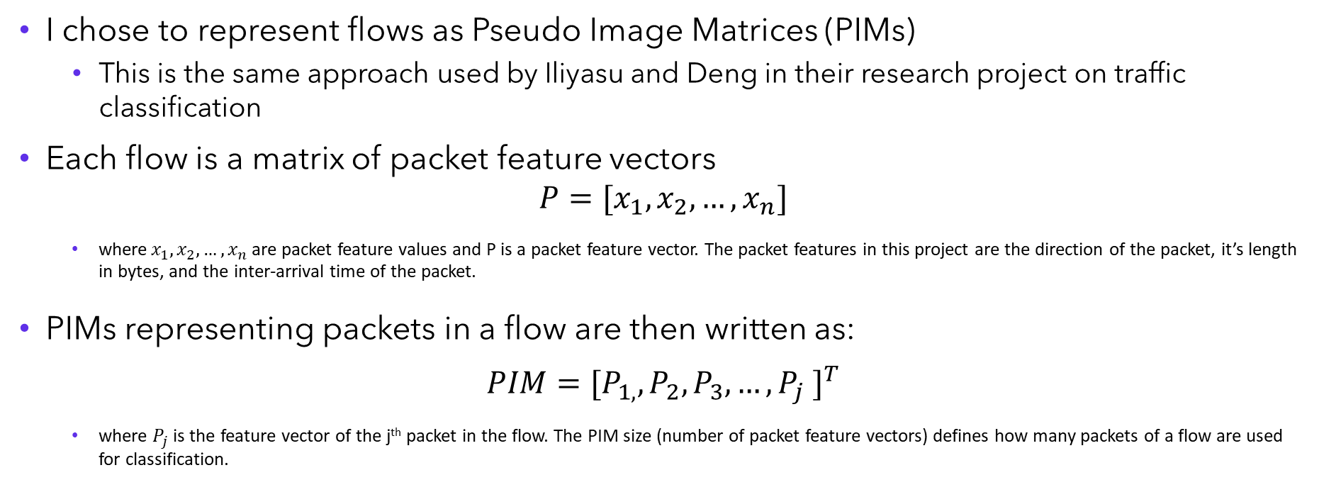
How are flows represented?
I chose to represent flows as Pseudo Image Matrices (PIMs)
This is the same approach used by Iliyasu and Deng in their research project on traffic classification
Each flow is a matrix of packet feature vectors
$$P=[x_{1},x_{2}, …,x_{n}]$$
where $x_{1},x_{2}, …,x_{n}$ are packet feature values and P is a packet feature vector. The packet features in this project are the direction of the packet, it’s length in bytes, and the inter-arrival time of the packet.
PIMs representing packets in a flow are then written as:
$$PIM={[P_{1,}, P_{2}, P_{3}, …, P_{j} ]}^{T}$$
where $P_{j}$ is the feature vector of the j^{th} packet in the flow. The PIM size (number of packet feature vectors) defines how many packets of a flow are used for classification.
Sources: (Iliyasu and Deng 2020)

Slide 12


PIM size Testing
A variety of tests were performed to find the optimum PIM size i.e. one that would provide a good classification accuracy but also enable a early/real-time classification
The graph shows how cross-entropy loss and accuracy on the validations set changes with PIM size
In the end 6 was chosen as the optimal PIM size

Slide 13

Why use a CNN?
It was decided to use a CNN to classify the PIMs
CNNs are proficient at solving computer vision problems and are designed under the assumption that data is input in the form of multiple arrays
As the CNN of this project is used to classify PIMs, it was named the PCNN

Slide 14
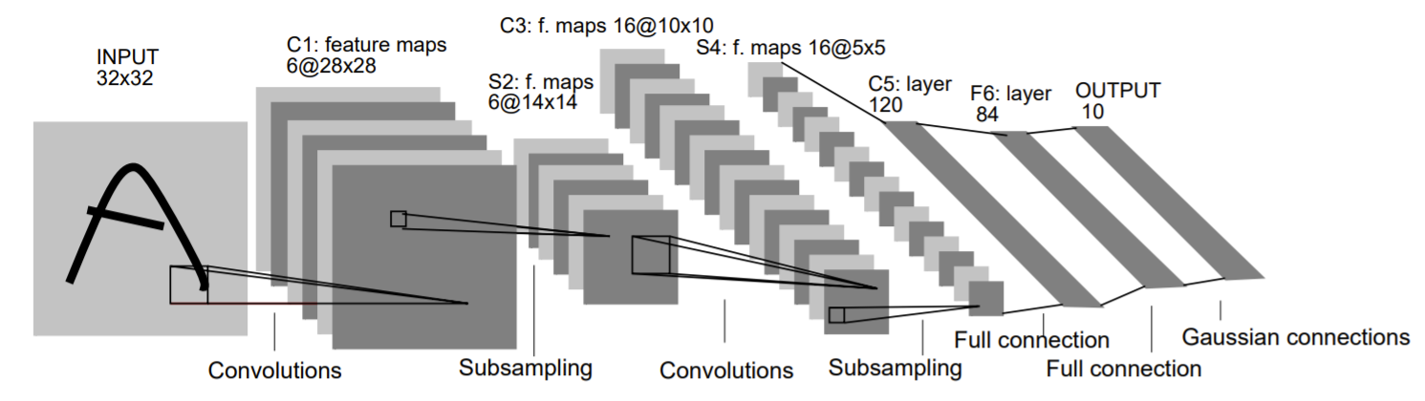
LeNet-5 architecture
The architecture of the PCNN was inspired by the LeNet-5 architecture

Slide 15

Optimising the PCNN architecture
Hyperparameter | Value Range
Learning Rate | 0.0001 – 0.01
Batch size | 64, 128, 256, 512
Epochs | 20, 40, 60
Drop out | 0 – 0.2
Number of filters | 10 – 100
Filter size of Conv1 | 3, 5, 7
Filter size of Conv2 | 3, 5
Number of Dense layers | 2-4
Number of neurons in Dense layers | 13 – 256
Number of neurons in final Dense layer | 13 – 128
Convolution Activation Function | Tanh or ReLU
Dense Activation Function | Sigmoid or ReLU
Using Ax Service API, the combination of hyperparameters that provided the maximum accuracy on the validation set were found

Slide 16
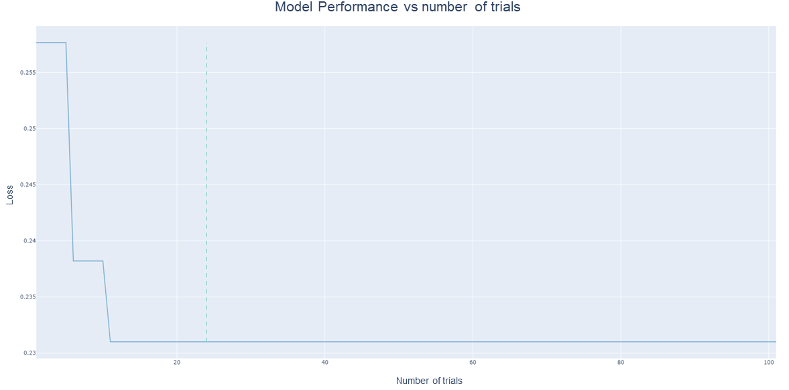
PCNN optimisation
Using a Gaussian process-based Bayesian optimization (GPEI) algorithm, Ax tested 100 different combinations to find the best architecture
In the graph loss = 1 – validation accuracy

Slide 17
The optimised PCNN architecture
The best loss achieved was 0.328 which corresponds to a validation accuracy of 67.2%
Hyperparameter | Value
Learning Rate | 0.0043917044909739175
Batch size | 512
Epochs | 60
Drop out | 0.05379819490458496
Number of filters in Conv1 | 86
Number of filters in Conv2 | 172
Filter size of Conv1 | 3
Filter size of Conv2 | 5
Number of Dense layers | 3
Number of neurons in Dense layers | 217
Number of neurons in final Dense layer | 66
Convolution Activation Function | Tanh
Dense Activation Function | ReLU

Slide 18
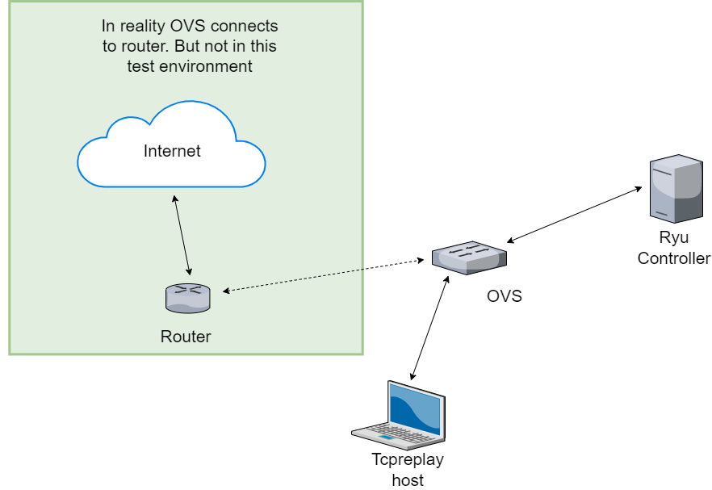
Making the test environment
Using mininet, a ryucontroller and tcpreplay a virtual SDN was made so that the PCNN could be deployed into an SDN and tested

Slide 19
Results
The PCNN’s performance was evaluated in 2 ways
It’s classification performance on the test set was evaluated
Then the speed of its classification was tested in the virtual SDN

Slide 20
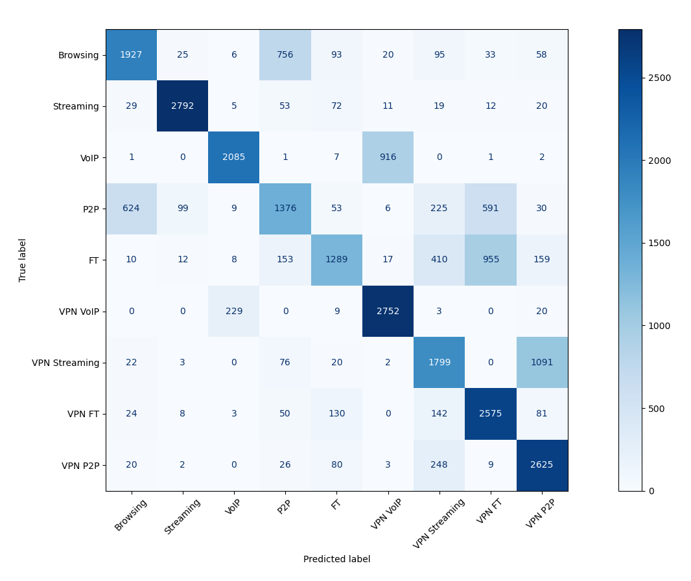
Results
Class Label | Accuracy | Recall | Precision | F₁ score
Browsing | 0.640 | 0.640 | 0.725 | 0.680
Streaming | 0.927 | 0.927 | 0.949 | 0.938
VoIP | 0.692 | 0.692 | 0.889 | 0.778
P2P | 0.457 | 0.457 | 0.552 | 0.500
FT | 0.428 | 0.428 | 0.735 | 0.541
VPN VoIP | 0.913 | 0.913 | 0.738 | 0.817
VPN Streaming | 0.597 | 0.597 | 0.612 | 0.604
VPN FT | 0.855 | 0.855 | 0.617 | 0.716
VPN P2P | 0.871 | 0.871 | 0.642 | 0.740
Weighted Avg | 0.709 | 0.709 | 0.718 | 0.702

Slide 21
PCNN vs classifiers of current literature
Research Paper | Metric | Result | Algorithm/NN
Draper-Gil et al. (2016) | Precision | 0.711, 0.783 | KNN, C4.5
Shapira and Shavitt (2019) | Accuracy | 0.884 | 2D CNN
Lotfollahi et al. (2020) | Precision | 0.93 | 1D CNN
Wang et al. (2017) | Accuracy | 0.999 | 1D CNN
This report | Accuracy | 0.709 | 2D CNN
This report | Precision | 0.718 | 2D CNN

Slide 22
PCNN vs classifiers of current literature
Research paper | Browsing | Streaming | Email | Chat | FT | P2P | VoIP | VPN Browsing | VPN Streaming | VPN Email | VPN Chat | VPN FT | VPN P2P | VPN VoIP
This report
Draper-Gil et al. (2016)
Shapira and Shavitt (2019)
Lotfollahi et al. (2020)
Wang et al. (2017)

Slide 23
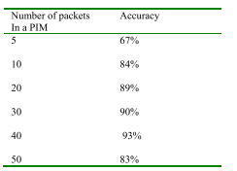
PCNN vs classifiers of current literature
With a PIM size of 6 the PCNN achieved an accuracy of 70.9%
This is 3% more than Iliyasu and Deng’s model did with a PIM size of 5
Research paper | Input matrix size
This report | 6x3 matrix padded to 12x12
Iliyasu and Deng | 20x3
Shapira and Shavitt | 1500x1500

Slide 24
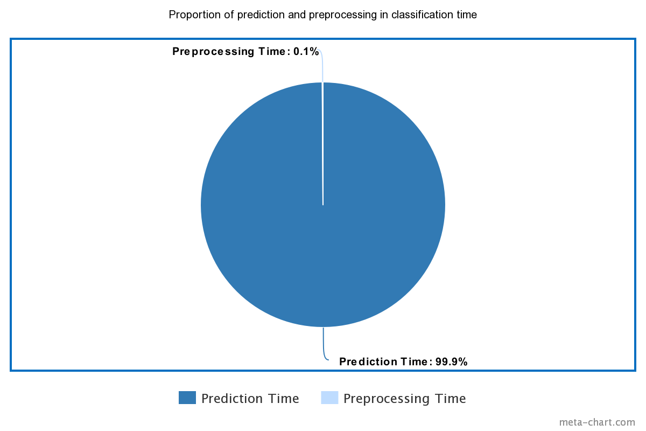
PCNN Classification Speed
Number of Flows | Classification time (s)
1 | 0.03951
10 | 0.408605
100 | 4.127323
1000 | 41.52464
10000 | 411.8418

Slide 25
Project Contributions
Showed that the PIM method can be extended to VPN encrypted traffic
More evidence that relatively accurate classification can be performed early (before the completion of an active flow)

Slide 26
Bibliography
Bernaille, L., et al. (2006). "Traffic classification on the fly." ACM SIGCOMM Computer Communication Review 36(2): 23-26.
Draper-Gil, G., et al. (2016). Characterization of encrypted and vpn traffic using time-related. Proceedings of the 2nd international conference on information systems security and privacy (ICISSP).
Hurley, J., et al. (2011). "Classifying network protocols: a ‘two-way’ flow approach." IET Communications 5(1): 79-89.
Iliyasu, A. S. and H. Deng (2020). "Semi-Supervised Encrypted Traffic Classification With Deep Convolutional Generative Adversarial Networks." IEEE Access 8: 118-126.
Lashkari, A. H., et al. (2017). Characterization of tor traffic using time based features. ICISSp.
Lotfollahi, M., et al. (2020). "Deep packet: A novel approach for encrypted traffic classification using deep learning." Soft Computing 24(3): 1999-2012.
Malik, A., et al. (2020). Intelligent SDN traffic classification using deep learning: Deep-SDN. 2020 2nd International Conference on Computer Communication and the Internet (ICCCI), IEEE.
Mohammed, A. R., et al. (2019). Machine Learning and Deep Learning Based Traffic Classification and Prediction in Software Defined Networking, IEEE.
Obasi, T. and M. O. Shafiq (2020). An experimental study of different machine and deep learning techniques for classification of encrypted network traffic, IEEE.
Shapira, T. and Y. Shavitt (2019). FlowPic: Encrypted Internet Traffic Classification is as Easy as Image Recognition, IEEE.
Wang, W., et al. (2017). End-to-end encrypted traffic classification with one-dimensional convolution neural networks, IEEE.
Wei, W., et al. (2017). Malware traffic classification using convolutional neural network for representation learning, IEEE.
Zander, S., et al. (2005). Automated traffic classification and application identification using machine learning, IEEE.

